Slide 1
SM using public data

Slide 2
SM (using 450k Reinius data)

Slide 3
Deconvolution Result

Slide 4
Deconvolution Result
Candace’s SM
Our SM

Slide 5
Deconvolution Result
Candace’s SM
Our SM

Slide 6
Our Pure PBMC data
Candace’s SM
Our SM

Slide 7
WGBS_PURE_PBMC
SM (using 450k Reinius data)

Slide 8
blueprint
SM (using 450k Reinius data)

Slide 9
WGBS_PURE_PBMC
blueprint

Slide 11
Accomando dataset
Candace’s SM
Our SM

Slide 12
Accomando dataset

Slide 13
Combined(hypo+hyper) SM from Reinius Data

Slide 14
Deconvolution Result(Reinius WB, PBMC, Granulocytes)
Only Hypo
Hypo+Hyper

Slide 15
Deconvolution Result(Reinius WB, PBMC, Granulocytes)
Only Hypo
Hypo+Hyper

Slide 16
Accomando dataset
SM (hypo+hyper)
SM(hypo)

Slide 17
SM based on our WGBS data (450k positions)

Slide 18
Test on Reinius pure data
SM (our wgbs)

Slide 19
Test on Blueprint pure data
SM (our wgbs)

Slide 20
Reinius data
Blueprint data

Slide 21
Test on Bulk PBMC

Slide 22
Accomando dataset
SM(WGBS based)
SM from Reinius data without considering Neu
Difference between FACS ground truth and Signature Matrix resolution

Slide 23
Accomando dataset
Difference between FACS ground truth and Signature Matrix resolution

Slide 24
Test on our Bulk PBMC(revisited)
SM(WGBS based)
SM from Reinius data without considering Neu
Difference between FACS ground truth and Signature Matrix resolution

Slide 25
Test on our Bulk PBMC(revisited)
SM (using 450k Reinius data)
Accomando Dataset
BULK PBMC
Difference between FACS ground truth and Signature Matrix resolution

Slide 26
Deconvolution Result(Reinius WB, PBMC)

Slide 27
Deconvolution Result(Reinius WB, PBMC)

Slide 28
SM based on Blueprint data

Slide 29
SM (Blueprint)
Reinius pure data

Slide 30
SM (Blueprint)
Our pure data

Slide 31
Comparison of two WGBS (450k position) SM
SM (Blueprint)
SM(Our data)

Slide 32
Comparison of two WGBS SM
On Reinius pure data
Using Blueprint SM
Using our data based SM

Slide 33
Comparison of two WGBS SM
On Reinius pure data
Using Blueprint SM
Using our data based SM

Slide 34
Test on Bulk PBMC
SM (BluePrint)
SM (Our Data)

Slide 35
Test on Accomando dataset
SM (BluePrint)
SM considering Neu (BluePrint)

Slide 36
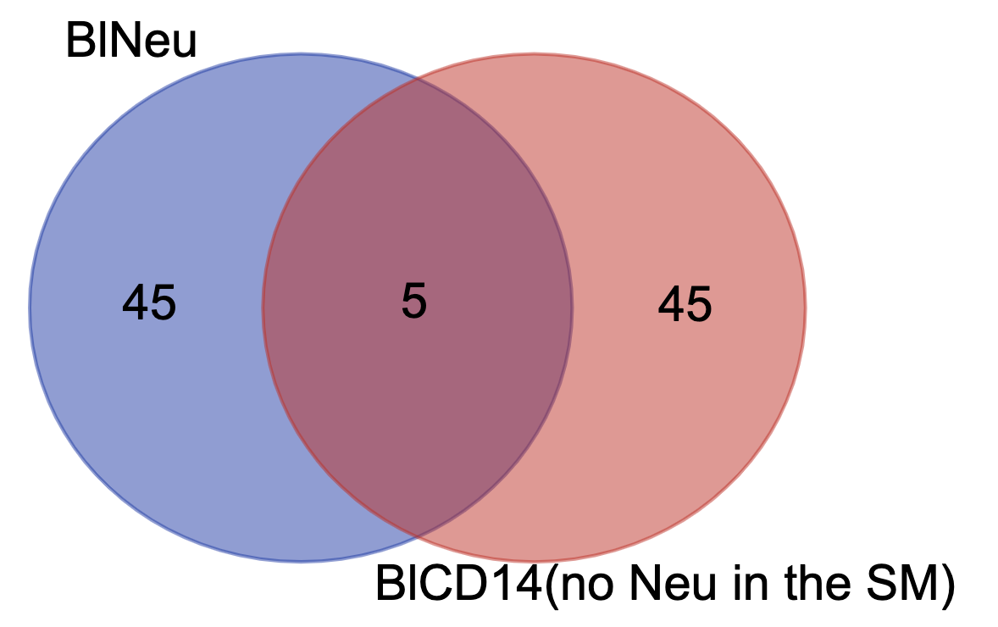
Neu, CD14 overlap in the SM
(SM with Neu)
Notes:
Neu vs CD14 (No Neu in the sm)

Slide 37
Test on our Bulk PBMC(revisited)
Difference between FACS ground truth and Signature Matrix resolution
And/Or
Difference between WGBS and 450k
Reinius SM(No Neu)
BluePrint SM (No Neu)
Reinius SM(Neu Normalized out)
BluePrint SM (Neu Normalized out)

Slide 38
Normalization Issue
(FACS: Neu Normalized out)
Higher Resolution SM can be normalized to match with FACS resolution
Lower Resolution SM does not work with normalized out higher resolution FACS
Platform dependent
Mixture
Notes:
Higher SM to Lower FACS But not otherway

Slide 39
Summary
(FACS: Neu Normalized out)
Higher Resolution SM can be normalized to match with FACS resolution
Lower Resolution SM does not work with normalized out higher resolution FACS
Platform dependent
Mixture
Notes:
cfDNA either Neu or CD14

Slide 40
Summary
(FACS: Neu Normalized out)
Higher Resolution SM can be normalized to match with FACS resolution
Lower Resolution SM does not work with normalized out higher resolution FACS
Platform dependent
Notes:
cfDNA either Neu or CD14

Slide 41
Summary
Mixture Information
Data Set | Samples included | Platform | Ground Truth Information
Reinius | PBMC | 450k | Neutrophil is Normalized Out
 | Whole Blood
 | Granulocyte
Accomando | Whole Blood
Our | Bulk PBMC | WGBS | No Neutrophil is reported in FACS
 | Bulk Tumor
 | CRC cfDNA |  | Corresponding PBMC FACS is used. No Neutrophil reported in FACS of corresponding PBMC.
Reinius | Purified PBMC subset: CD4, CD8, CD14, CD19, CD56 | 450k | Neutrophil is not considered
Blueprint |  | WGBS
our
Signature Matrix (SM) resolution information
NeutrophilNormalizedOut: In the SM we have Neutrophil. After deconvolution Neutrophil part has been normalized out
withoutNeutrophil: Did not consider Neutrophil in the SM generation process

Slide 42
Performance on CRC cfDNA
SM(Reinius)
SM(Candace)
SM(Blueprint)
(Considering Only CBC)

Slide 43
Performance on CRC cfDNA
SM(Reinius)
SM(Candace)
SM(Blueprint)
(Scaling Neutrophils with Respect to Lymphocytes)
(Scaling Neutrophils with Respect to Monocytes)

Slide 44
Mann-Whitney test on Deconvolution Result
Notes:
All mann whitney on blug50 hypo

Slide 45
Mann-Whitney test on Deconvolution Result

Slide 46
Mann-Whitney test on Deconvolution Result

Slide 47
Mann-Whitney test on Deconvolution Result

Slide 48
Mann-Whitney test on Deconvolution Result

Slide 49
Mann-Whitney test on Deconvolution Result

Slide 50
Mann-Whitney test on Deconvolution Result

Slide 51
Round Robin Signature Matrix Analysis Summary
Data Set
Sample
Platform
Mixture
PMN
Platform
Data Set
Signature Matrix
Notes:
*visualization

Slide 52
Performance on CRC cfDNA
Scaling Neutrophils with Respect to Monocytes
SM : Reinius
SM : Candace
SM : Blueprint
Notes:
*Visualization

Slide 53
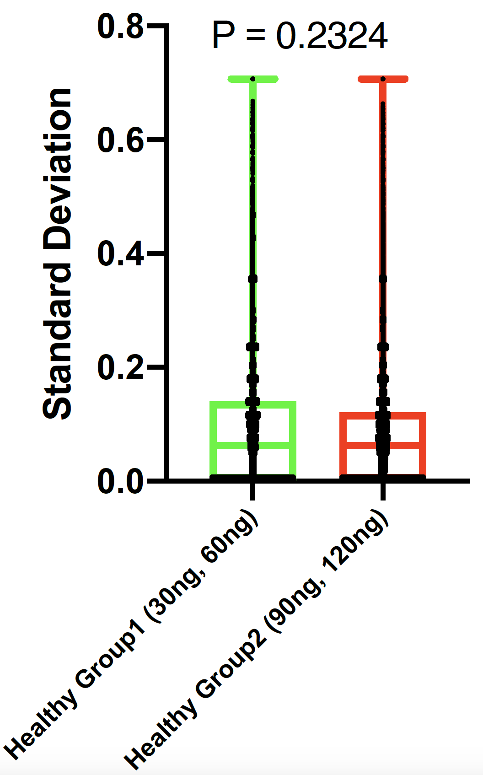
Does Standard deviation change with input amount?
One sample per input amount
(randomly selected 10⁶ CpG)

Slide 54
Does Standard deviation change with input amount?

Slide 55
Performance on CRC cfDNA
Corrected Ground Truth
SM : Reinius
SM : Candace
SM : Blueprint

Slide 56
Performance on CRC cfDNA
Corrected Ground Truth (Combined Lymphocytes)
SM : Reinius
SM : Candace
SM : Blueprint

Slide 57
Looking for a better SM algorithm
Current SM: single CpG resolution
Can we go for block level?
metilene (CBS based) can provide DMR (region of CpG)
Combine DMR based on some criteria (condition number)
Notes:
Block level may tolerate the noise

Slide 58
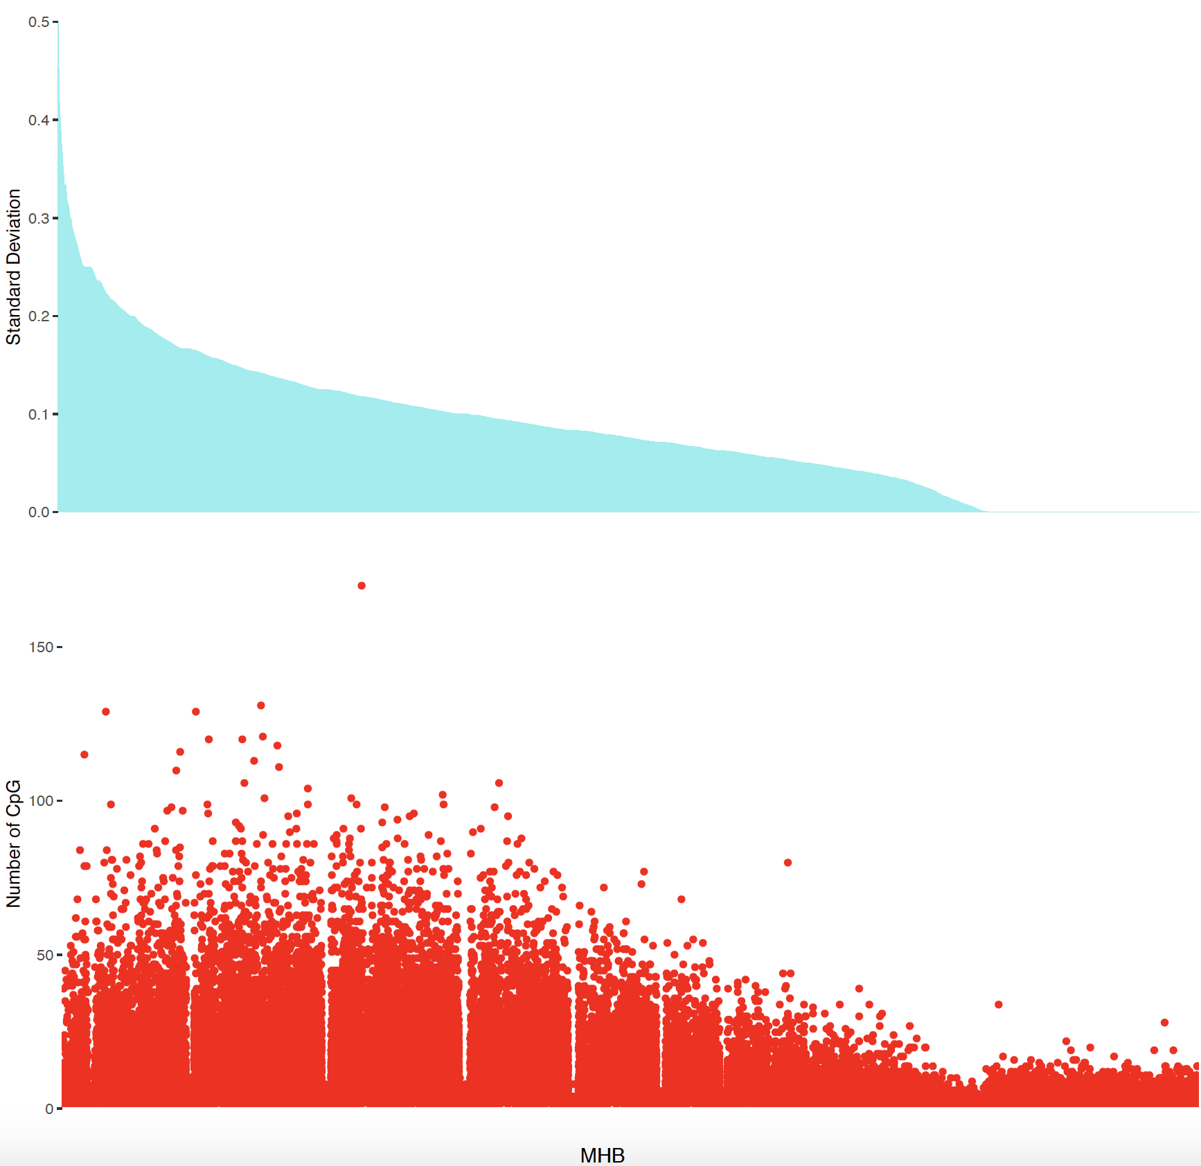
CD19 PBMC (1382)

Slide 59
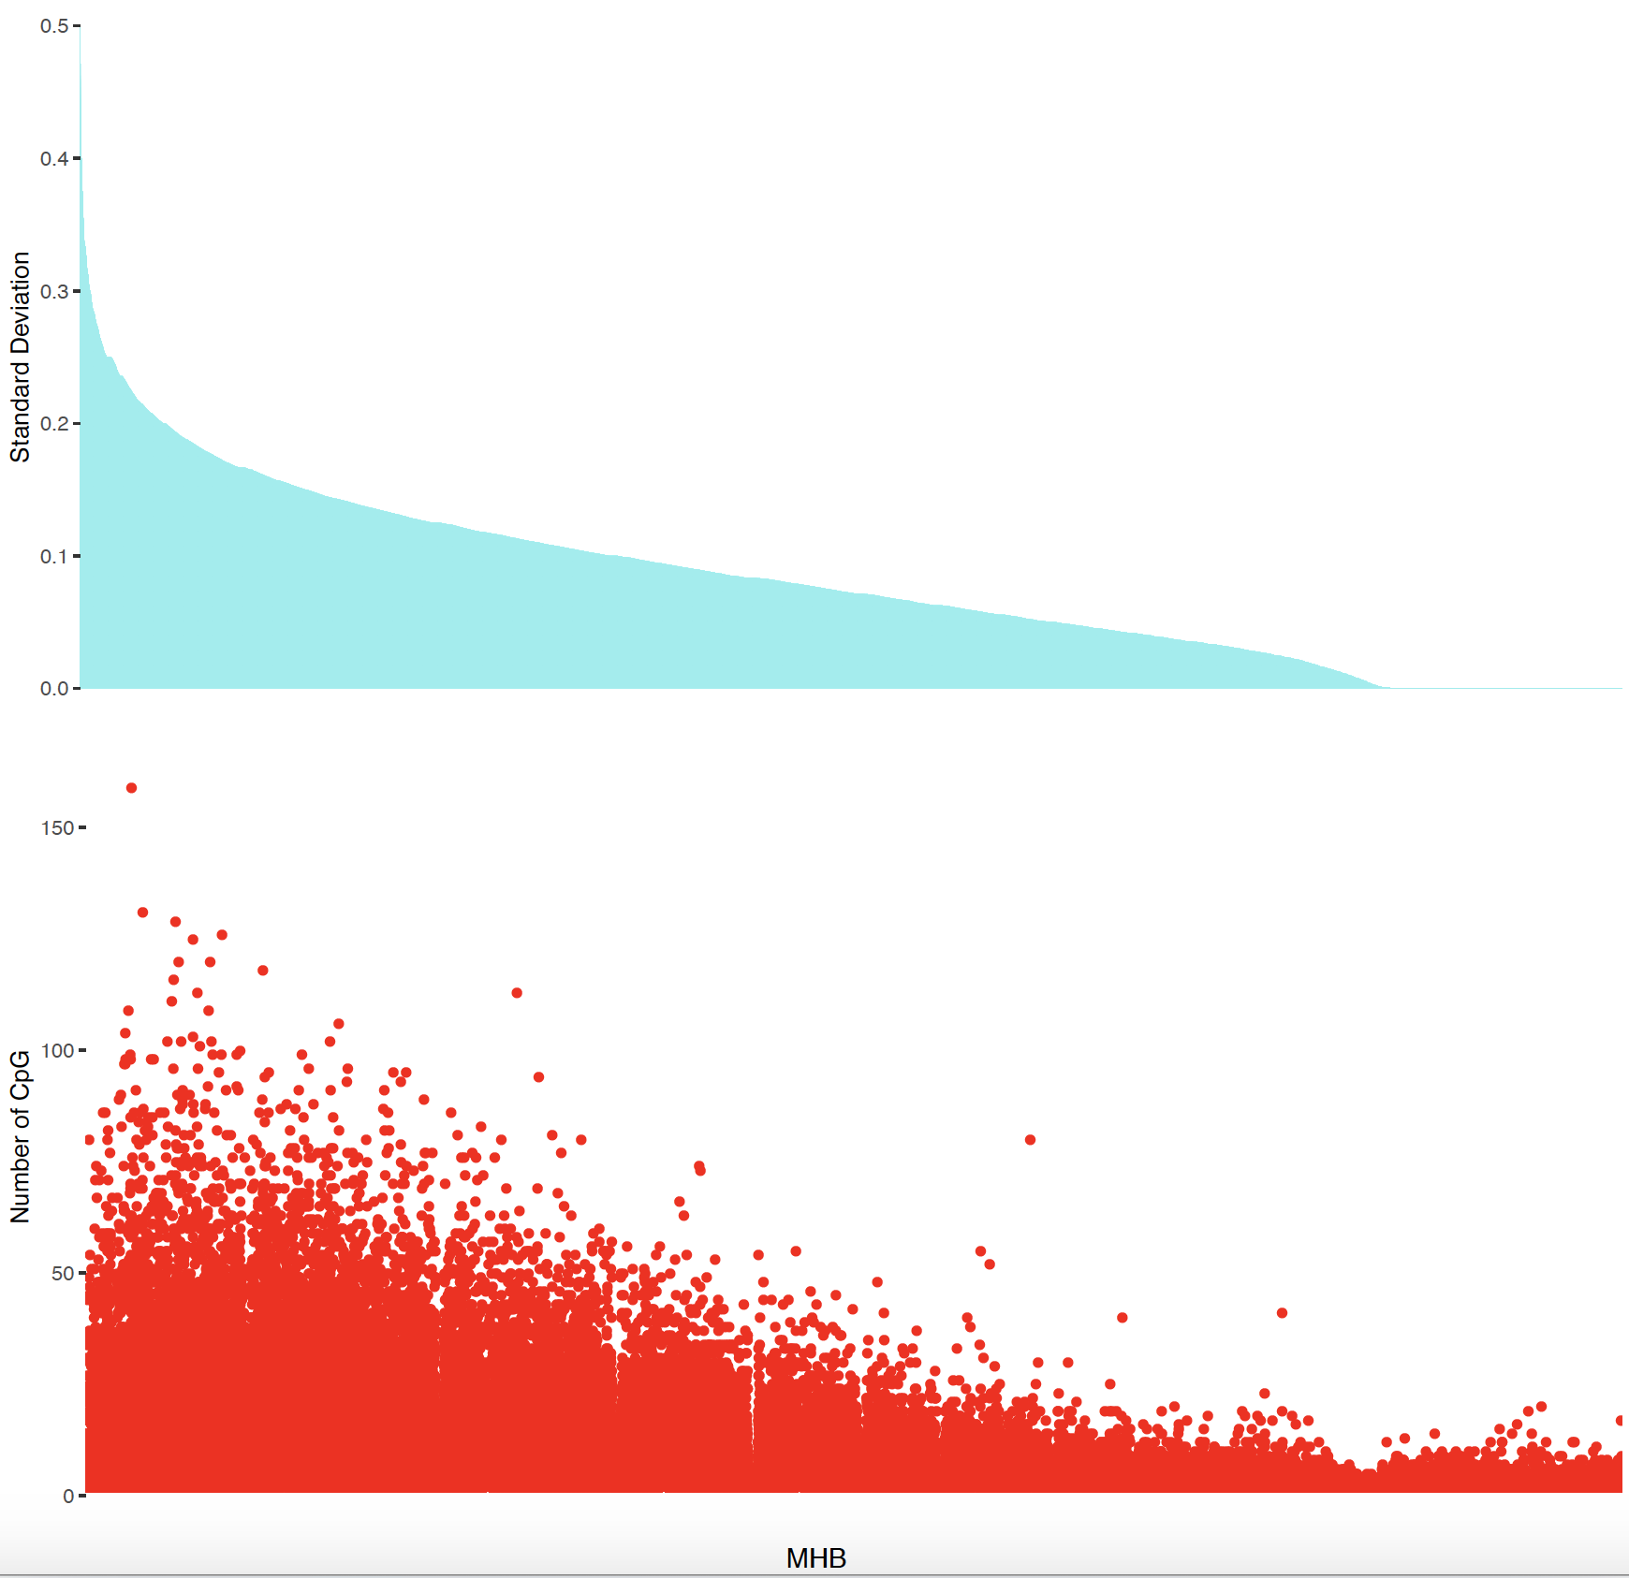
CD19 PBMC (1313)

Slide 60
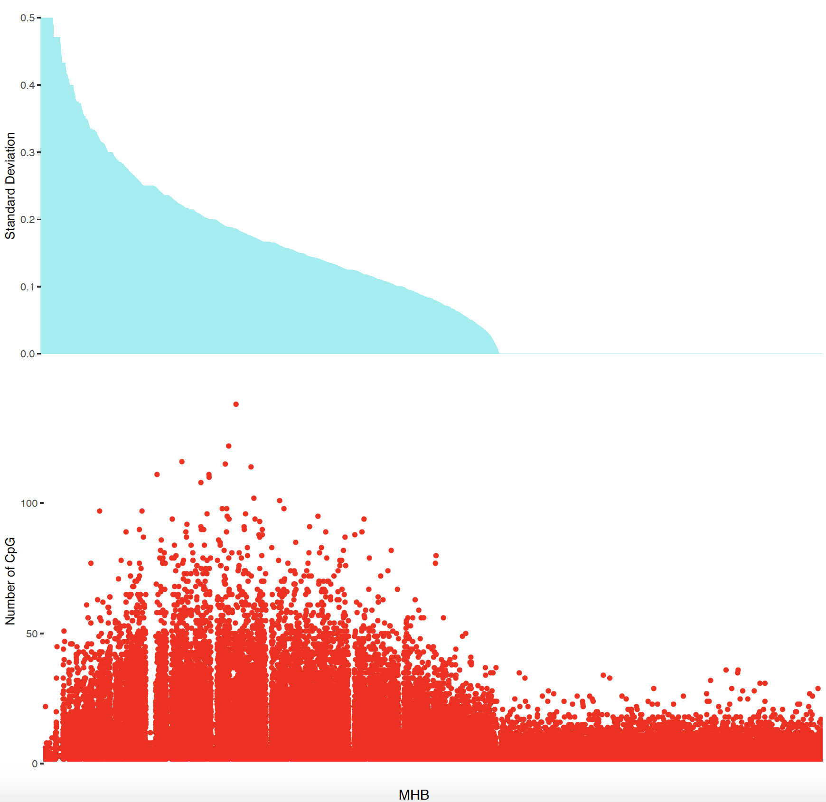
CD19 TIL (1382)

Slide 61
Supp

Slide 63
Performance on CRC cfDNA
Corrected Ground Truth(noah_ar _first version)
SM : Reinius
SM : Candace
SM : Blueprint

Slide 64
Mann-Whitney test on predicted CD14

Slide 65
Performance on CRC cfDNA (Scaling Neutrophils with Respect to Lymphocytes)
SM(Reinius)
SM(Candace)
SM(Blueprint)
SM (Our WGBS)

Slide 66
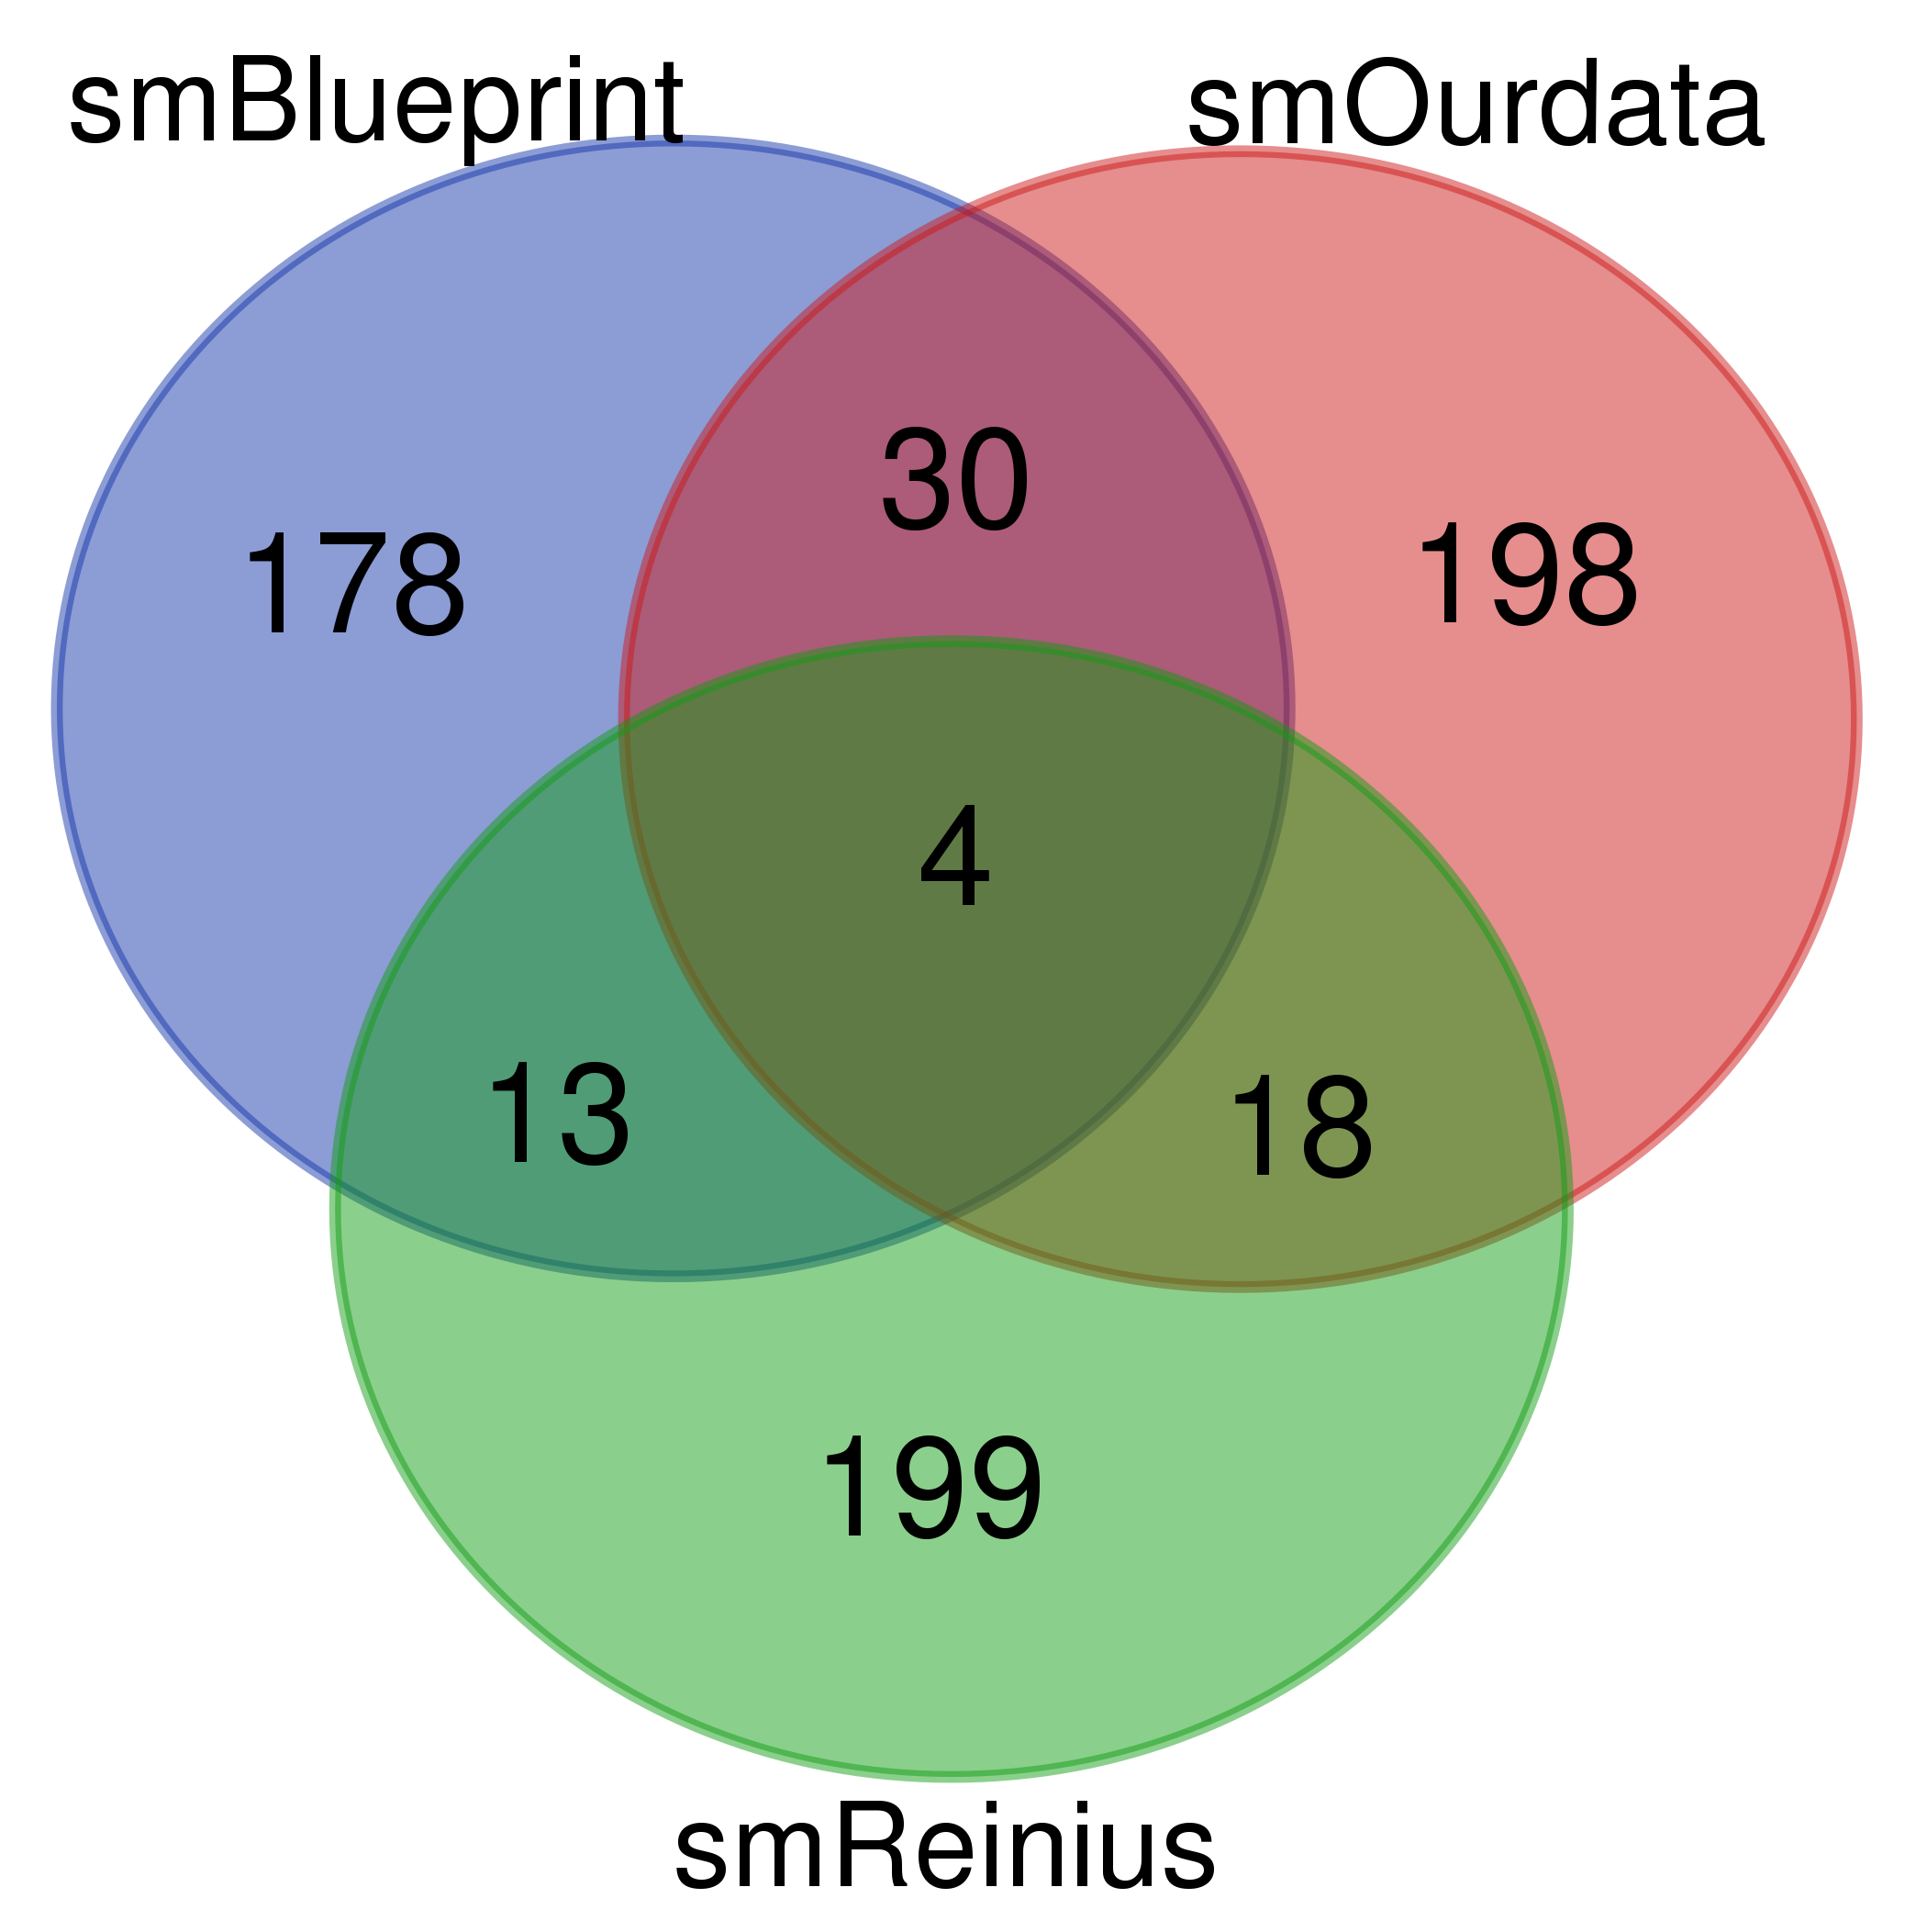
CpG overlap
Notes:
Leukocyte hypo resolution

Slide 67
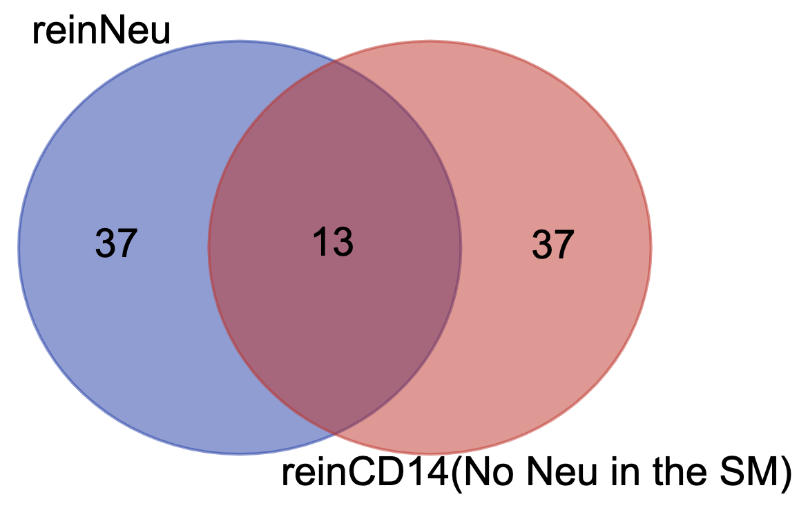
Neu, CD14 overlap
Notes:
Neu vs CD14 (No Neu in the sm)

Slide 68
Summary
(FACS: Including Neu)
Mixture

Slide 69
ALL SM and Mixture
Notes:
*pure gt result is slightly wrong(worse) here
Because of including Neu

Slide 70
Performance on CRC cfDNA
SM(Reinius)
SM(Candace)
SM(Blueprint)
SM (Our WGBS)

Slide 71
Test on our Bulk PBMC(revisited)
SM (Our Data)
BluePrint SM (No Neu)
BluePrint SM (Neu Normalized out)

Slide 72
Bulk PBMC
SM (using 450k Reinius data)

Slide 73
On CRC cfDNA
Our WGBS SM
BL_no_Neu SM

Slide 74
Summary (FACS Neu Normalized)
Mixture

Slide 75
Candace’s SM

Slide 76
Candace’s SM
SM (using 450k Reinius data)

Slide 77
blueprint
SM (using 450k Reinius data)

Slide 78
WGBS_PURE_PBMC
blueprint

Slide 79
Hypo+hyper wgbs based SM
Our PBMC
Notes:
Wgbs_g50_g15_450pos

